Slide 1
EMPLOYEE SALARY ANALYSIS USING EXCEL

Slide 2
DESCRIPTION ABOUT DATA
This project focuses on analyzing employee salary data across different departments
using Excel. The main goal is to understand how salaries vary between departments
and identify patterns or trends in income distribution.

Slide 3
PROCESS
Checked dataset structure (features, data types, null values)
Identified and handled missing data
Verified unique values using filters
Removed duplicate records
Segmented data based on key features
Grouped data using Pivot Tables
Created charts for visualization
Analyze patterns and trends

Slide 4
WORKFLOW OF DATA ANALYSIS
COLLECTION OF DATA
UNDERSTANDING DATA AND BUSINESS PROBLEM
DATA CLEANING
DATA TRANSFORMATION
EXPLORATORY DATA ANALYSIS
DATA VISUALIZATION
PRESENT FINAL INSIGHTS

Slide 5
1. collection of data
Collected this data from Kaggle by checking their rows , columns and null values.
2. UNDERSTANDING DATA AND BUSINESS PROBLEM
To analyze employee salary data using Excel
To understand salary distribution across different departments
To compare average salaries between departments
To identify patterns and trends in compensation
To create interactive dashboards using Pivot Tables and charts
To generate meaningful insights for better decision-making

Slide 6
DATA CLEANING
Checked for null values - No null values
Checked for duplicates - No duplicates
Checked rows and columns - R – 1200 C- 17
data transformation
Dataset prepared for analysis.
Features made easier to understand and compare.
Ready for visualization and further analysis.

Slide 7
exploratory data analysis
Performed data cleaning (handled null values and duplicates)
Explored dataset using filters and sorting
Analyzed unique values in each feature
Segmented data based on departments
Used Pivot Tables for grouping and summarization
Calculated average salary by department
Compared salary distribution across categories
Created charts (bar chart, pie chart) for visualization
Identified patterns and trends in salary data

Slide 8
ANALYSIS AND VISUALIZATION

Slide 9
Finance department has the highest average salary
HR department shows the second highest average salary
Marketing follows closely after HR
IT department has the lowest average salary
Part-time employees has highest count
Contract type employees shows the
second highest count which follows closely
to part-time
Compare to part-time and contract
employees Full-time employees has lowest
count

Slide 10
Employees who have completed PHD has
the highest count
Employees who have completed MASTER
Degree has second highest count
Employees who have completed BACHELOR
Degree has third highest count which follows
closely to MASTER Degree
Employees who have completed HIGH SCHOOL
has lowest count of employees compare to others
FINANCE Department has the highest
average performance score at 5.0
HR Department has the second highest
average performance score at 4.96 which
is closely to finance
MARKETING Department has third highest
average performance score at 4.9
IT Department has the lowest score at 4.8
compare to others

Slide 11
HR Department has the highest count of employes
IT Department has the second highest count of
employees
MARKETING Department has the third highest count
of employees
FINANCE Department has the lowest count of
employees compare to others
52% of Employees preference remote work
48% of Employees not prefer remote work

Slide 12
LA City has the highest Max . Salary at 1,49,815
DELHI City has the second highest Max . Salary at
1,49,774
TORONTO City has the third highest Max . Salary at
1,49,547
KARACHI City has the fourth highest Max . Salary at
1,49,289
NY City has the lower to other 4 cities which
difference between 731
LONDON City has lowest to others
FINANCE Department has the highest
average working hours
IT Department has the second highest
average working hours
HR Department has the third highest
average working hours
MARKETING Department has the lowest
to compare othes but closely to HR

Slide 13
In that 6 cities NY has the highest performance
score
Second highest LONDON at about 1018
Least score has KARACHI at about 921
ANALYST job role has the highest salary
MANAGER job role has second highest
Salary which difference between
24,13,537
DESIGNER job role has the third highest
salary Which closely to MANAGER
DEVELOPER job role has the lowest
compare to others

Slide 14
FINAL INSIGHTS

Slide 15
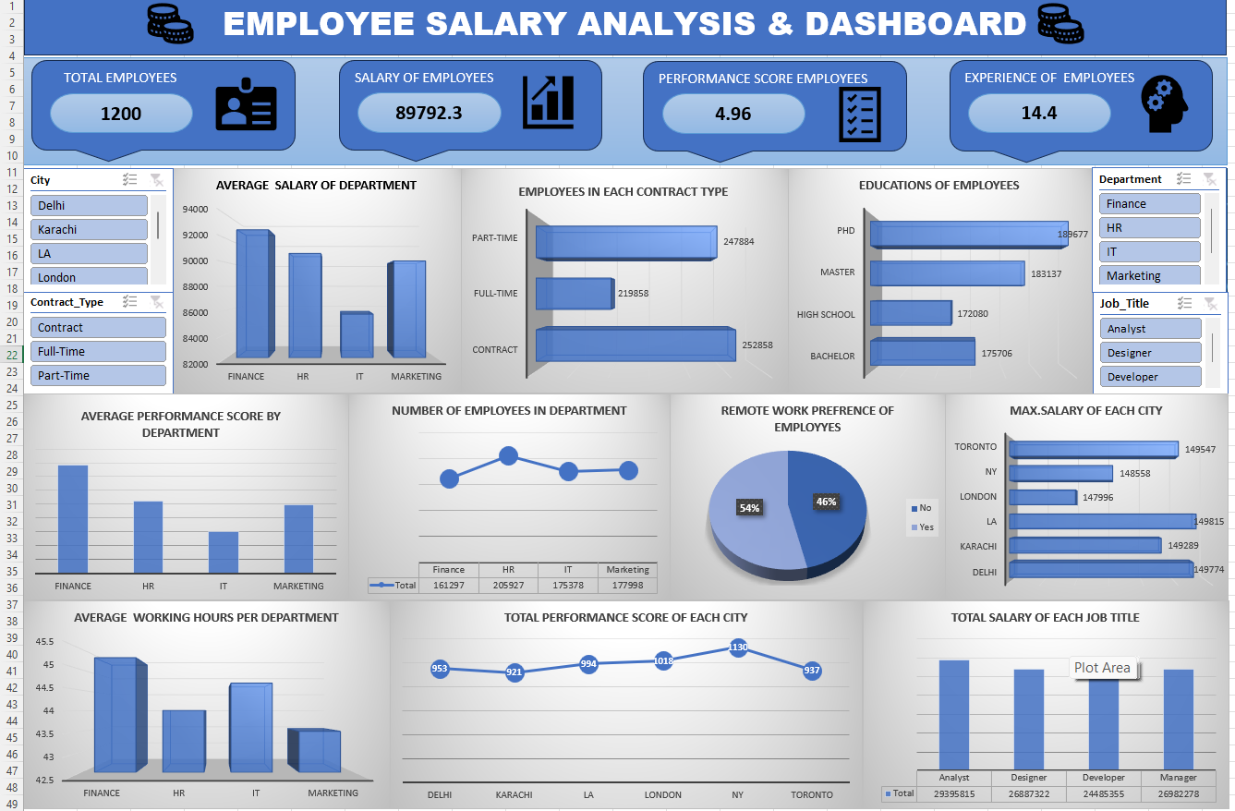

Slide 16
Finance is the strongest department (high salary + performance + workload)
IT needs improvement in salary and performance
For future prediction :
IT salaries may increase to match other departments
Demand for tech roles will push salary growth
PhD holders are the highest → company prefers highly qualified employees
For future prediction :
More companies will prefer Master’s & PhD candidates
Competition will increase for high-skilled jobs

Slide 17
Company relies more on flexible workforce (part-time & contract)
Workforce is highly educated
Work preference is shifting toward remote work
Low-performing areas (like Karachi will get attention
Companies may invest in training & skill development
👉 “Overall, the company is strong in finance and highly educated workforce, but future growth will
depend on improving IT performance, adapting to remote work trends, and balancing workforce structure.”

Slide 18
THANK YOU

